Slide 1

Computer Graphics
CS C 471 and IS C 471
Dr. Lucy J. Gudino
Computer Science & Information Systems Group
Birla Institute of Technology & Science, Pilani, Goa Campus

Slide 2
Clipping and Polygon filling

Slide 3
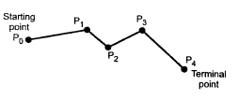
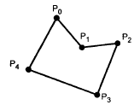
Introduction
Polyline is a chain of connected line segments
  first vertex➔ initial point or starting point
  Last vertex ➔ final or terminal point
if starting point and terminal point are same ➔ polyline is closed ➔ polygon

Slide 4
Types of Polygons
The classification based on where the line segment joining any two points within the polygon is going to lie
2 types
  convex :
    line segment joining any two points within the polygon lies completely inside the polygon
    Every internal angle is less than or equal to 180⁰
  concave
    line segment joining any two points within the polygon may not lie completely inside the polygon
    A concave polygon will always have an interior angle with a measure that is greater than or equal to 180 degrees.

Slide 5
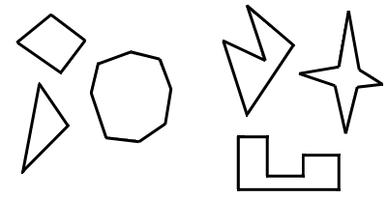
Contd…

Slide 6
Clipping
Extraction of data/primitives inside a region of interest “window”
  Discard primitives outside window
Point Clipping
Line Clipping
Polygon Clipping

Slide 7
Clipping is tricky!
Clip
In: 3 vertices
Out: 6 vertices
Clip
In: 1 polygon
Out: 2 polygons

Slide 8
Clipping
Point Clipping : Remove points outside window
  Need to decide whether a point is inside the window or not
  Xmin <= x <= Xmax
  Ymin <= y <= Ymax
Xmax, Ymax
P.
Q .
Xmin, Ymin

Slide 9
Clipping
Line Clipping : Remove portion of line segment outside window
Can we use point clipping?

Slide 10
Cohen and Sutherland Clipping Alogorithm
Algorithm by Cohen and Sutherland
  Quickly detects and dispenses with two common cases called “Trivial accept” and “Trivial reject”
  Uses “inside outside code word”

Slide 11
Simple Cases
  If x₀ < x_{min} and x₁ < x_{min}
  or x₀ > x_{max} and x₁ > x_{max}
  or y₀ < y_{min} and y₁ < y_{min}
  or y₀ > y_{max} and y₁ > y_{max}
  trivial rejection.
  If x_{min} ≤ x ≤ x_{max}
  and y_{min} ≤ y ≤ y_{max}
  trivially accepted.
y_{max} y_{min}
x_{min} x_{max}
y_{max} y_{min}
x_{min} x_{max}

Slide 12
Cohen and Sutherland Clipping Algorithm
Inside – Outside Code Word (Out Code)
Above W
Below W
Right W
Left W
P .

Slide 13
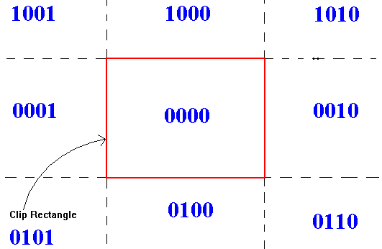
Cohen and Sutherland Clipping Algorithm
  Region and outcodes
  From MSB:
  First bit: above top edge y > y_{max}
  Second bit: below bottom edge y < y_{min}
  Third bit: to right of right edge x > x_{max}
  Fourth bit: to left of left edge x < x_{min}

Slide 14
Cohen and Sutherland Clipping Algorithm
  Checking for trivial acceptance or rejection using outcodes
      1). Each endpoint of a line segment is assigned an outcode (tag);
      2). If both 4-bit codes are zero, the line can be trivially accepted;
      3). A logical and is performed on both outcodes;
      4). If the result is nonzero, the line can be trivially rejected.

Slide 15
Cohen and Sutherland Clipping Algorithm
5) If not trivially reject and accept case
  Line is potentially visible
If potentially visible
  Subdivide into segments and apply trivial acceptance and rejection test
  Segments by intersection with window edges
  Edges in any order but consistent (eg. Top-bottom, right-left

Slide 16
Algorithm
if (EC1 == EC2 == 0000)
accept the line
if ((EC1 & EC2) != 0)
reject the line
Else clip the line against an edge (where bits are nonzero)
Assign the new vertex a 4-bit value
Return to 1
Note: EC is end code

Slide 17
Cohen and Sutherland Clipping Algorithm
Summary:
Divide and conquer strategy
Simple, still popular (most windows are rectangular)
Limited to rectangular region
Extension to 3D clipping using 3D orthographic view volume is straightforward

Slide 18
